Slide 1

Commercial Graph
a map of financial relationships
Michael J. Radwin
@michael_radwin
Notes:
Imagine the social graph where personal relationships are replaced by commercial relationships based on real financial data. Imagine the possibilities for small businesses to grow, connect, transact and prosper.
Intuit is uniquely qualified to achieve just this. We are entrusted with the collective data of 50 million consumers and small businesses. It is a unique pool of data that covers the financial spectrum – ranging from individual purchase history to business inventories.
At Intuit, we are building the Commercial Graph with the consumer and small business data from products like Mint.com, Quicken, and QuickBooks.
We take millions of user-entered, and hence unstructured, business descriptions and billions of transactions and apply Hadoop based deduplication algorithms for normalization, and machine learning for categorization. In order to better understand the graph, we compute metrics such as connected components, centrality, and commercial PageRank.
We will examine several applications of the commercial graph, including finding more customers like your best customers, optimizing your vendors, and relevant offers & recommendations to help our customers make and save money.
A deep-dive on technical architecture will discuss use of Giraph as a Hadoop based large scale graph processing platform and neo4j as a real-time graph datastore.

Slide 2
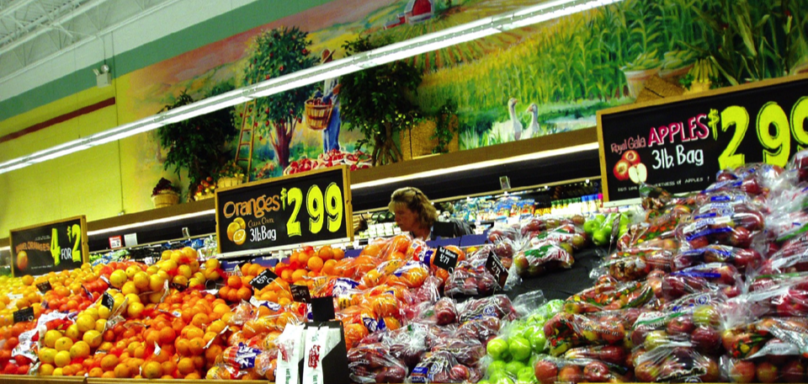
  Consumers are looking for easy ways to
  save money on everyday purchases
“I love coupons but hate the hassle”
“These daily deals are junk. Yoga and cupcakes?!?”

Slide 3
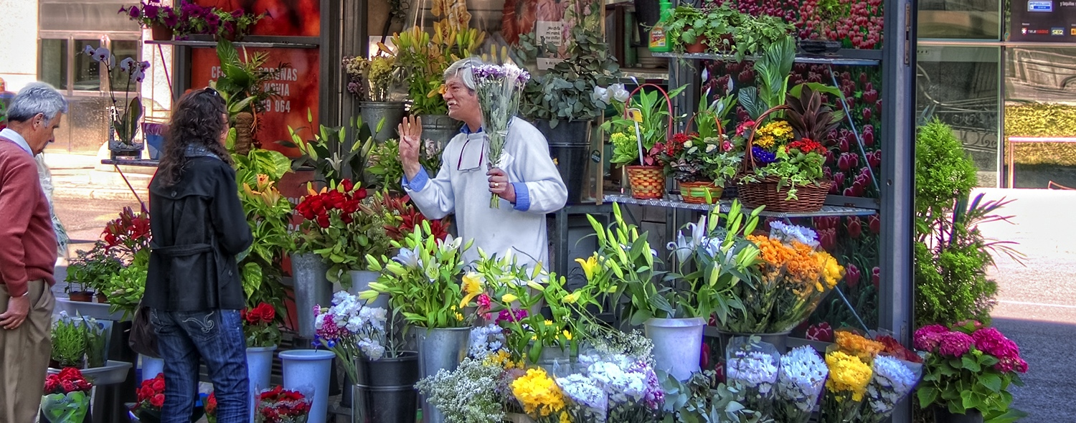
  Small businesses want to find new customers
  and retain existing customers with positive ROI
Flickr: marcp_dmoz
“How do I accurately identify and reach my target customer demographic?”
“How can I tailor my offers based on my customers’ spending habits?”

Slide 4
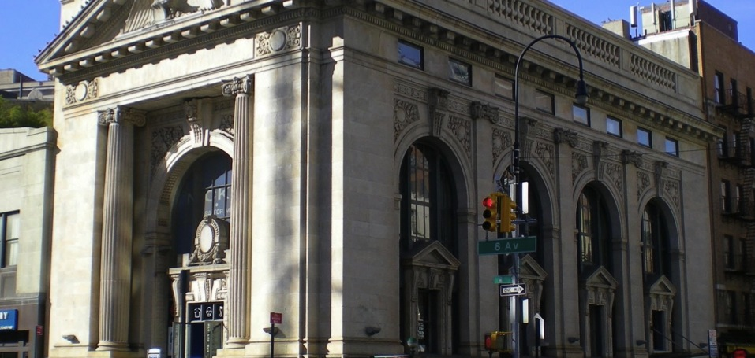
  Financial Institutions want to grow revenue while
  simultaneously increasing customer satisfaction
“How can I return value to my customers and become their financial hero?”
“How can I increase loyalty and engagement while driving behavior that grows revenue?”

Slide 5







Improving the lives of 60M people
Notes:
Whether helping to balance a checkbook, run a small business or pay income taxes, our innovative solutions have simplified millions of people’s lives.

Slide 6

…creates a unique and compelling set of data
1 in 3
Tax Returns
Pay
7 Million
1 in12
Mobile Customers
Americans
From
$2.6T
1 to 50
in Transactions
Apps
25 Million
Questions Answered
45M Customers Using Connected Services

Slide 7

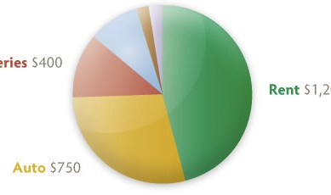
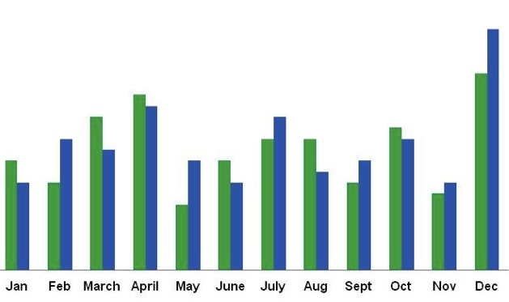
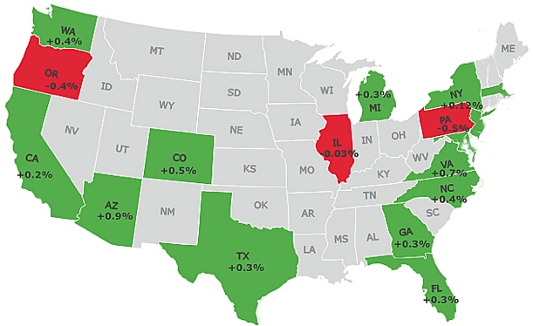
Spending Profiles
Revenue Comparisons
Small Business Hiring Trends
Rent
$1,200
Groceries
$400
Auto $750
Am I spending more than my friends?
My revenue increased 5%...is that good?
Is it time to hire?

Slide 8
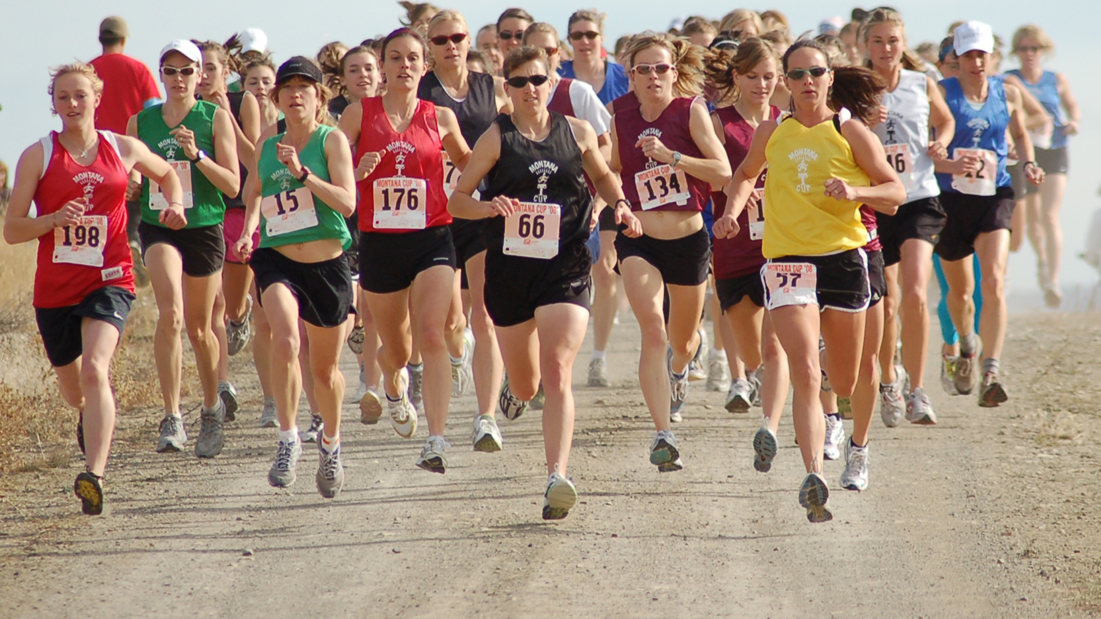

Slide 9
Big Data
for the Little Guy

Slide 10
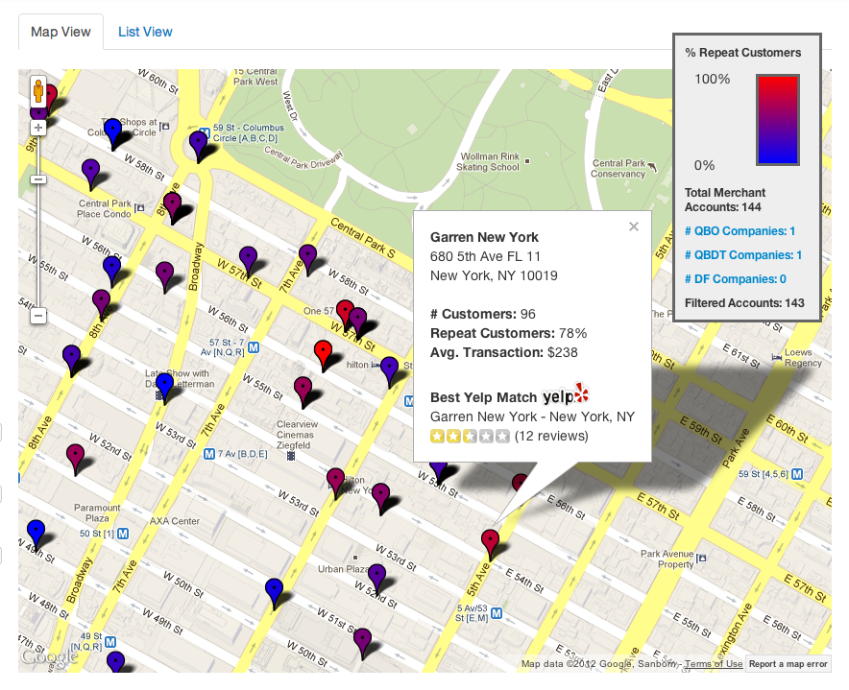
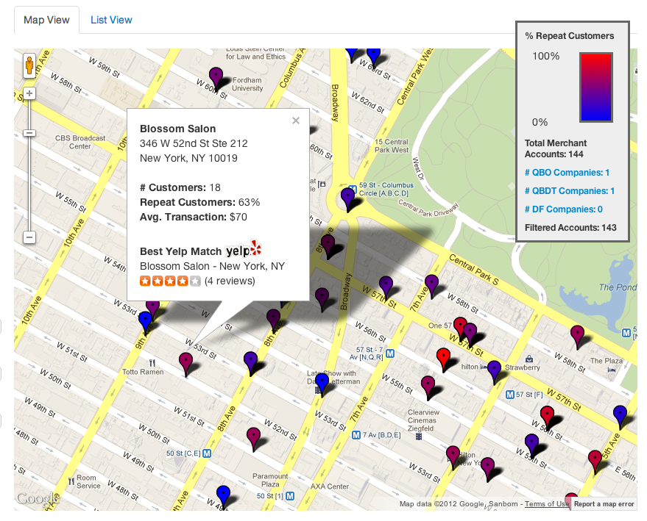
Demo: verified spend = Real ratings

Slide 11
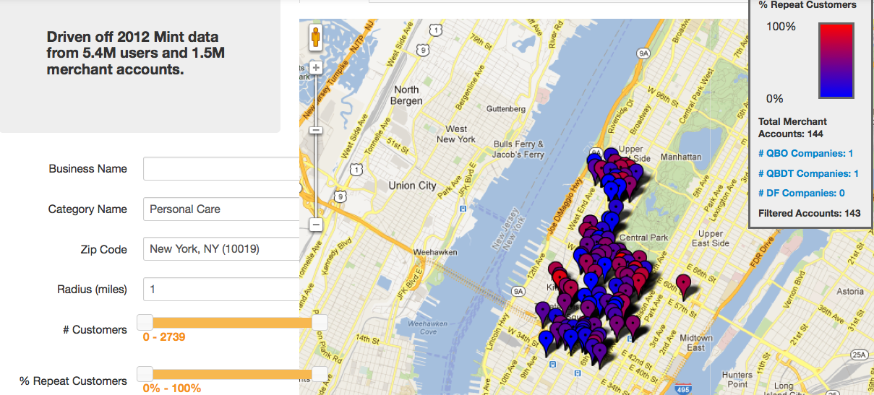
How many salons, spas, and cosmetics stores?
There is no lack of choice! So, how do you know which businesses offer quality services and drive repeat business? Let’s see where Mint users vote with their dollars...

Slide 12
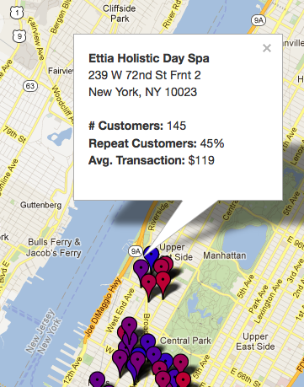
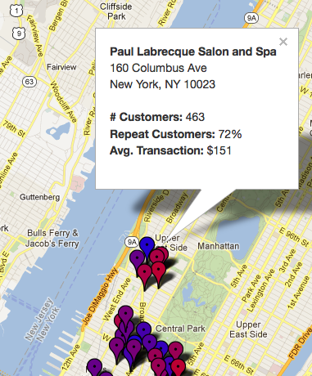
Ettia has a lower avg price, but only 45% repeat customers.
Maybe it’s worth paying slightly more to go to Paul Labrecque, which has 72% repeat business?
Notes:
After the conference – which spa to try?

Slide 13
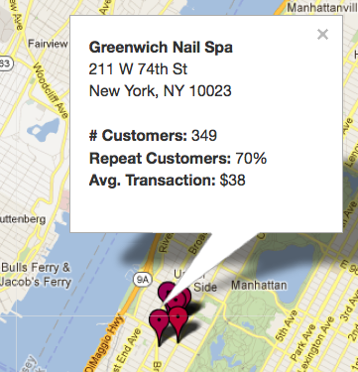
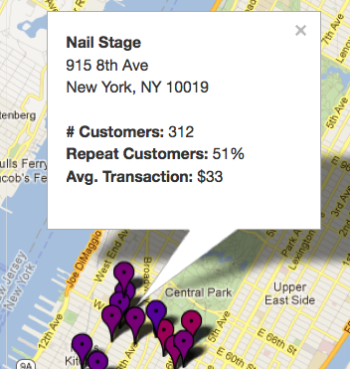
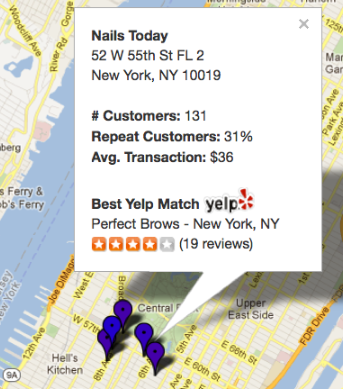

Three nail spas, one from each third of the ratings scale..
Greenwhich Nail Spa has 70% repeat business whereas only 50% of Nail Stage customers return within a 12 month period.
Nails Today has an even lower percentage of repeat customers (30%), but maybe this is due to the touristy location?

Slide 14








Commercial Graph Architecture
Real-time Applications
Invoices, bills, payments, vendors, customers
Request
Response
Categorization
Matching/De-duping
Transactions
Offline analytics
8m nodes (de-duped)
1.2b edges
$1.6T spend (annual)
Business names, address, phone, industry code

Slide 15
Transaction Categorization
Your bank statement says POS TGT X89G CHIC IL 87.66
We use plain English
Target for $87.66
Automatically files it in the right category every time, across all your accounts
Notes:
A core component of the Financial Transaction Classifier is the Merchant Matching Service
Provides fuzzy-matching capabilities against a comprehensive database of every merchant in the US
The service returns the merchant name, business category, address, geo-coordinates, phone number, web address, etc.
The input to the service is whatever partial information is known about the merchant, even if that information includes mistakes such as misspelling
The Merchant Matching Service itself enables new applications
Offers and recommendations
Auto-completion of merchant and customer data

Slide 16


Fuzzy matching & de-duplicating entities
Company 15682314
Company 25461129
vendor_id: 311005395
name: The Windsor Press, Inc.
address: PO Box 465 6 North Third Street
city: Hamburg
state: PA
zip: 19526
phone: (610) 562-2267
vendor_id: 94811556
name: The Windsor Press
address: P.O. Box 465 6 North 3rd St.
city: Hamburg
state: PA
zip: 19526-0465
phone: (610) 562-2267
DUNSNUM: 002114902
Name: The Windsor-Press Inc
Street: 6 N 3rd St
City: Hamburg
State: PA
Zip: 19526-1502
Phone: (610)-562-2267
Canonical representation:
Notes:
Match based on attributes, output score between 0-1
Step 1: Generate multiple candidate mappings
Lookup in local lucene index
Step 2: Identify the best candidate mapping from Step 1
apply custom scoring algorithm.
Name, Address, Email use String Similarity approaches
Address has state restriction
If no state and no zip code, no match attempted

Slide 17






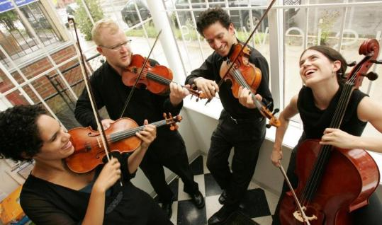
Referrals & recommendations
Connecting consumers with small businesses
Small business micro-communities
Notes:
R5, especially for related industries: Wedding planner, photographer, florist, musicians, catering
Sm biz needs a Janitorial service
Some janitorial services specialize in the medical industry
So simply looking looking up in the yellow pages under janitorial you might not find the right biz
Can you find a service provider that is specialized for your industry?
Peppermint experiment – email campaign to matchmake between (oil & gas, medical, churches, Trucking, General Contractors)
Referrals a la DemandForce. Vision, dentistry, automotive
Linking our ecosystems. Find a gardener. Live experiment with solar panel installation
Micro-communites
Connects SMBs for peer advice, business referral, and collaboration
SMBs request and receive advice from peer SMBs
Share business leads with other SMBs
Find SMB partners to form buying cooperatives

Slide 18
Recommendation as a Graph Problem
V
Q
V
Many recommendation tasks can be formulated as finding the “missing” link on the commercial graph
Q
V
Q
V
Example: the vendor you may be interested in
Q
V
V
Notes:
How do we build a recommendation?
The model is to assume that the graph was complete, but some links were randomly deleted
What’s the likelihood that there was an edge between these two nodes?

Slide 19
Giraph for Community Finding
A quality community finding algorithm is hard to implement as a series of MapReduce jobs
Can be formulated as an optimization solved with simulated annealing:
  Blondel et al (maximize modularity)
  Rosvall et al (minimize description length of a random walker)
Steps of annealing are much more easily implemented as batch-sync processes
Notes:
One way of finding those missing links in the graph is to detect communities
Communities in this context are dense structures in the graph
Some communities do a lot of business together
There’s a multi-resolution view of the overall graph
Consumers or vendors
Groups of like-minded sub-networks – they do more business within the community than outside the community
Communities also give you a hierarchy: geographic, such as zip/city/state, or by industry
Simulated annealing/hill climbing – solve for a global optimization while climbing hills in a distributed fashion (not getting stuck on a local maxima)
Iterative algorithms are HARD on MapReduce. Even PageRank (a well-known iterative algorithm), if you do 100 iterations, requires 100 MapReduce jobs

Slide 20
Node 2 Community Assignment
C3
3
C1
C2
5
4
7
1
6
2
Naturally implemented as messages passed between community nodes
Notes:
Most Graph algorithms are iterative in nature
Iterative algorithms can be implemented as message-passing between nodes
What Giraph does is load all nodes into memory. Provide a messaging infrastructure for nodes.
Giraph does everything in a large Map (only reduces at the very end). Giraph implements the batch-sync model.
Does this in rounds called “super steps”. You send a bunch of messages and then it ends (Round 1). Then, after everyone has sent 1 message, we go to the 2nd step.
During the animation
If I join a different community, what would be the gain in a global sense?
Entropy will be reduced

Slide 21
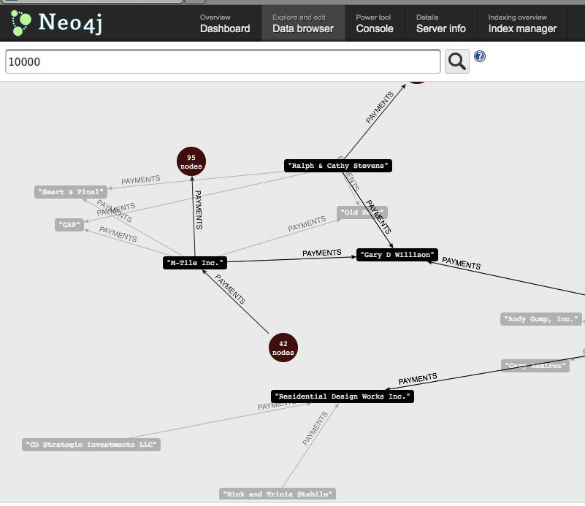
Neo4j for real-time graph applications
Cypher Query Language
START biz = node(100) MATCH biz– [TRANSACTS]- x RETURN x
Great for…
Needs work…
Real time
Cypher
Built-in Algos
Lucene search
Horizontal scale
Access controls
Open Source community
Notes:
Cypher Query Language example: Identifying immediate neighbors of a business using relationships
Advantages
Graph is persisted to disk
so you could compute graph metrics, persist on the graph itself and iterate, for eg. Computing derived attributes like centrality
Can be used as standalone as well as embedded JAR in your application.
Search powered by Lucene on all key-value properties.
Common Graph algorithms implemented
Doing friend of a friend queries are straightforward
Does not require an additional platform like Hadoop(in the case of Giraph)
Weaknesses
No scale out option, only vertically scalable.
No horizontal scaling, so no sharding of DB.
Unlike a regular RDBMS, does not implement any access control out of the box.
Smaller community compared to other OS projects like Hadoop (but active nevertheless)

Slide 22
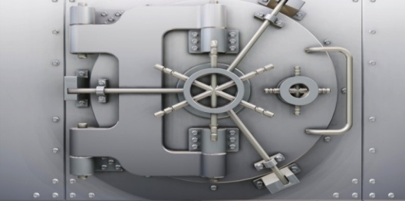


Privacy matters…a lot.
Build the right team.
Experiment. Measure. Pivot. Persevere.
Notes:
It’s not our data – it’s our customers’ data. We build data-driven innovation on a strong foundation of trust.
A great data scientist isn’t just a coder or a great statistician. She’s curious. Deep customer empathy. A passion for business problems.
From: decisions by “politics and Powerpoint” To: “enable ideas to prove themselves”. Minimal Viable Product. Build-measure-learn rapid experimentation loop.

Slide 23
Thank you.

